Slide 1
Waste Management Analysis
Data
Leveraging AI for Efficient Waste Handling BY Group No 1
Atharva Domale

Slide 2
Objective
Analyze waste sensor data to understand patterns and trends.
Build predictive models for efficient waste management.

Slide 3
Agenda
Introduction
Info of Dataset & Data Types
Steps
Steps Included in Code
Data Visualization & Preprocessing
Visualization of Various plots
Feature selection & transformation
VARIANCE INFLATION FACTOR
(VIF) & PRINCIPAL COMPONENET ANALYSIS
(PCA)

Slide 4
Agenda
Model Building
Training and Testing Dataset
Model Training
Model details
Ensemble Method, Hyperparameters,
Feature Importance, Robustness, Accuracy
Comparison of models
Logistic Regression, SVM, KNN, Decision Tree
Conclusion

Slide 5
Dataset Infographics
The dataset contains a mix of continuous and categorical data types. Dataset contains 20,000 rows and 7 columns.
Categorical Data:
Timestamp
timestamp is a time-based variable. While not strictly continuous or categorical, it can be treated as a time series variable.
Sensor_id :
Represents the ID of a sensor.
Waste_type :
Describes the type of waste (e.g.,"recyclable“, "non_recyclable“, "organic").
01
02
Info
Continuous Data:
04
inductive_property
capacitive_property
moisture_property
infrared_property
03
There are no missing values, and data types include integers, floats, and strings. The dataset is structured for analysis of waste types based on sensor properties, with examples such as recyclable, non-recyclable, and organic waste categories.

Slide 6
Steps
1. Import Libraries
4. Data visualization
Import all required libraries like pandas, matplotlib, seaborn, and scikit-learn.
Create graphs to explore relationships between different columns.
2. Load Dataset
5. Data Preprocessing
Load the dataset from your computer using pandas.
Clean the data by removing duplicates, handling missing values, and normalizing features.
3. About Dataset
6. Model Building
Display information such as column names, data types, first five rows, and last five rows.
Train and test classification models like Random Forest and XGBoost for waste type prediction.

Slide 7
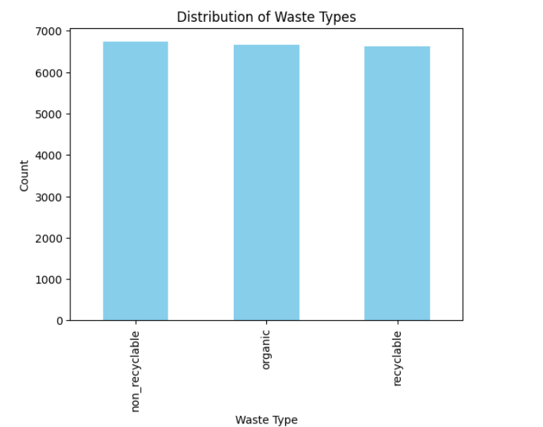
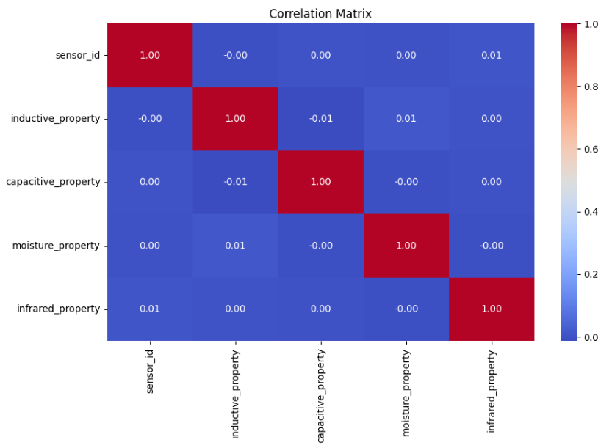
DATA VISUALIZATION
Bar chart of waste type distribution.
Heatmap of feature correlations.

Slide 8
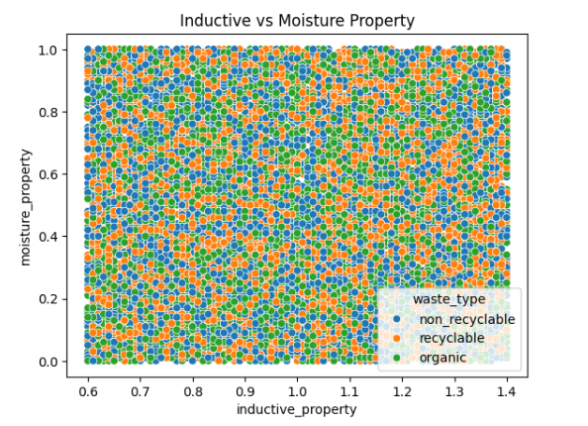
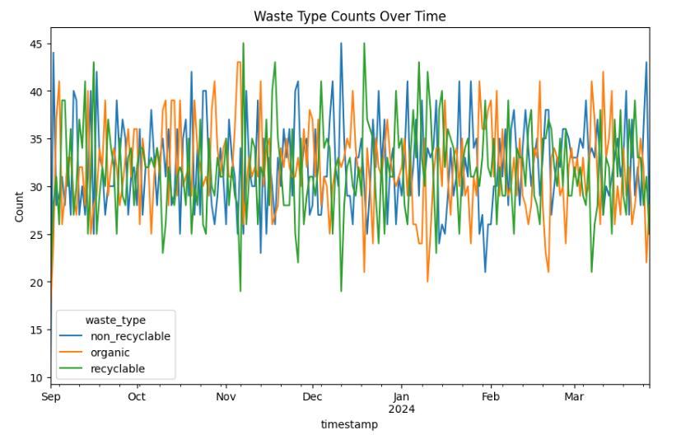
DATA VISUALIZATION
Scatterplot (e.g., inductive vs. moisture property).
Line plot showing waste type trends over time.

Slide 9
DATA PREPROCESSING
Handling missing values (e.g., mean imputation).
Label encoding for categorical data.
Feature scaling using standardization.
Outlier detection and treatment &
Feature engineering

Slide 10
FEATURE SELECTION & TRANSFORMATION
PRINCIPAL COMPONENET ANALYSIS
(PCA)
VARIANCE INFLATION FACTOR
(VIF)
Variance inflation factor (VIF) is a statistical tool that measures the severity of multicollinearity in a regression model
Principal component analysis (PCA) is a statistical technique that reduces the number of dimensions in a dataset while retaining the most important information.

Slide 11
MODEL BUILDING
01
02
Training and testing dataset
Model Training
04
03
Prediction
Metrics -
Confusion matrix, Classification Report, Accuracy

Slide 12
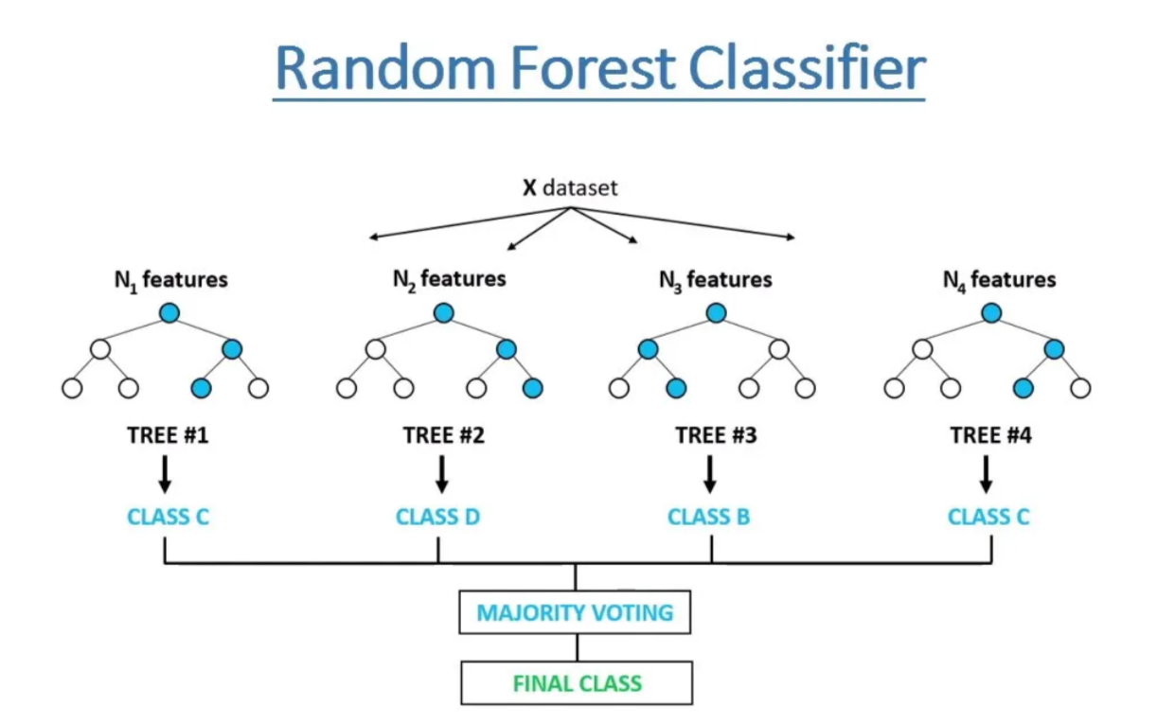
RANDOM FOREST CLASSIFIER
A Random Forest classifier is an ensemble learning method that builds multiple decision trees and combines their predictions to improve accuracy and prevent overfitting. It works by randomly selecting subsets of features and training a separate decision tree on each subset. During prediction, each tree makes a vote, and the class with the majority vote is selected as the final output. Random Forest is highly effective for classification tasks, handling both numerical and categorical data well, and is robust to noise and overfitting compared to a single decision tree.

Slide 13
MODEL DETAILS
Ensemble Method
Feature Importance
Hyperparameters
Combines multiple decision trees to improve accuracy and reduce overfitting.
Identifies the most influential features, aiding interpretability of the model.
Used 100 estimators, no maximum depth, and class balancing for optimal performance.

Slide 14
MODEL DETAILS
Robustness
Accuracy
Handles noise and outliers effectively, ensuring consistent predictions.
Achieved the highest accuracy among all tested models, proving its effectiveness.

Slide 15
COMPARISON OF MODELS
74%
73%
75%
74%
Logistic Regression
Support Vector Machine (SVM)
K-Nearest Neighbors (KNN)
Decision Tree
Achieved moderate accuracy limited by its linear nature, making it less effective for complex patterns in the dataset.
Performed well with non-linear relationships but required extensive parameter tuning.
Struggled with high-dimensional data and larger dataset size, resulting in lower accuracy.
Performed adequately but prone to overfitting due to its hierarchical structure.

Slide 16
COMPARISON OF MODELS
70%
76%
74%
Naive Bayes
Random Forest
XGBoost
Worked well for categorical features but underperformed with continuous sensor data.
Delivered competitive accuracy but required more computational resources and hyperparameter tuning.
Best-performing model with high accuracy, leveraging feature importance and ensemble learning for robust predictions.
Highlight: Random Forest was the most effective due to its ability to handle feature interactions and robustness against noise.

Slide 17
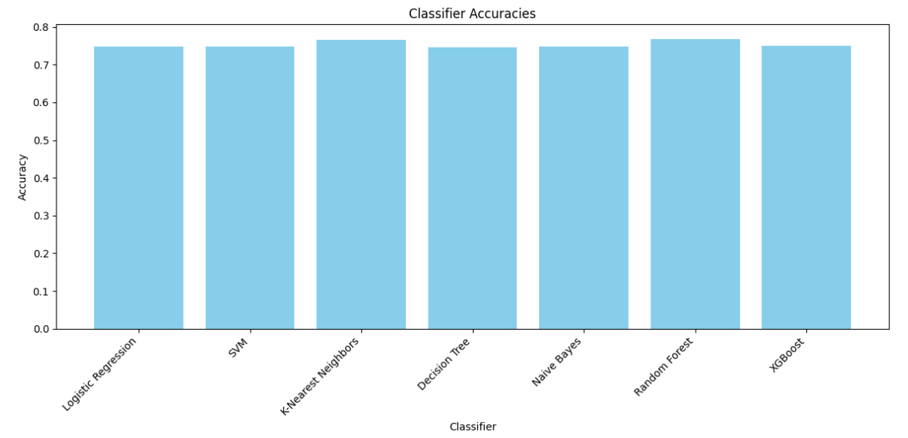
Result

Slide 18
CONCLUSION
01
Random Forest achieved high accuracy.
Model Performance
02
Preprocessing and feature engineering optimized the model.
Data Preparation
03
Visualization helped uncover key patterns.
Visualization
04
Machine learning can improve waste management efficiency.
Impact

